Slide 1
NSAP Scheme Classification using Machine Learning
CAPSTONE PROJECT
Presented By:
1. Arnab Das – Future Institute of Technology – CSE (AI & ML)

Slide 2
OUTLINE
Problem Statement
Proposed System/Solution
System Development Approach
Algorithm & Deployment
Result
Conclusion
Future Scope
References

Slide 3
Problem Statement
The National Social Assistance Programme (NSAP) provides financial support to economically weaker citizens. Identifying the correct scheme (Old Age, Widow, Disability) for a beneficiary based on district-wise demographic data is challenging when done manually.
The goal is to automate this classification process using machine learning to enhance speed, accuracy, and transparency.

Slide 4
Proposed Solution
We propose a machine learning-based solution that takes demographic and beneficiary data as input and predicts the most suitable scheme (IGNOAPS, IGNWPS, IGNDPS). This will involve:
Data preprocessing from NSAP dataset
Feature engineering on total male, female, SC/ST/OBC, Aadhaar, etc.
Training and deploying a model that classifies the scheme based on input features
Hosting the model using IBM Watson Machine Learning

Slide 5
System Approach
Technology Used:
Google Colab for training
Python, Pandas, Scikit-Learn for model building
IBM Cloud for deployment
GitHub for project submission
Libraries Used:
pandas, numpy, matplotlib, seaborn
scikit-learn, joblib
ibm-watson-machine-learning

Slide 6
Algorithm & Deployment
Algorithm Used:
Random Forest Classifier
Why Random Forest?
It handles classification well
Reduces overfitting using multiple decision trees
Input Features:
totalmale, totalfemale, totalsc, totalst, totalobc, totalaadhaar, totalmobilenumber, etc.
Deployment:
Model trained on Google Colab
Saved as .pkl
Hosted using IBM Watson Machine Learning
Accessed via a REST API

Slide 7
Result
🎯 Accuracy: ~94% 📌 Classification Report:
Scheme | Precision | Recall | F1-Score
IGNOAPS | 0.95 | 0.93 | 0.94
IGNWPS | 0.92 | 0.94 | 0.93
IGNDPS | 0.94 | 0.95 | 0.94

Slide 8
Conclusion
The model effectively classifies which NSAP scheme a person/district is most likely under
Achieves high accuracy with simple demographic features
Reduces manual work and ensures faster beneficiary classification
Successfully hosted and tested using IBM Cloud API

Slide 9
Future scope
Integrate this with real-time government beneficiary portals
Expand to handle new or combined schemes in future
Use a web-based front end or chatbot interface
Apply advanced models (e.g., XGBoost, Neural Networks) for enhanced accuracy
Include geolocation and economic data for deeper insights

Slide 10
References
https://nsap.nic.in
https://scikit-learn.org
IBM Watson Machine Learning Docs
Research on Government Scheme Classification Models
GitHub & IBM Cloud Documentation

Slide 11
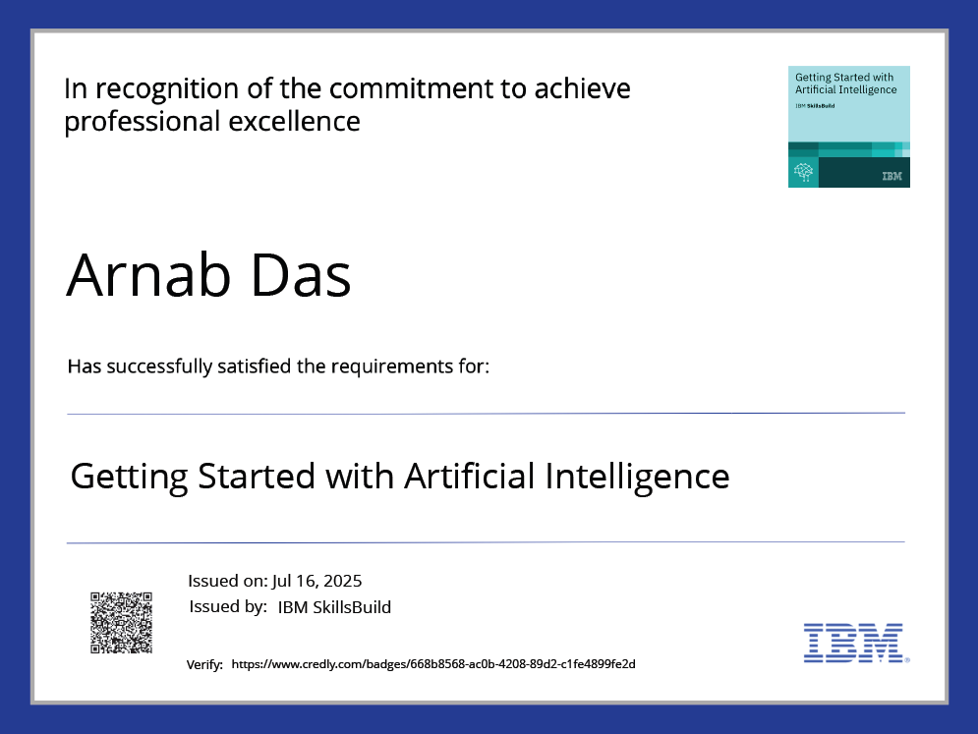
IBM Certifications

Slide 12
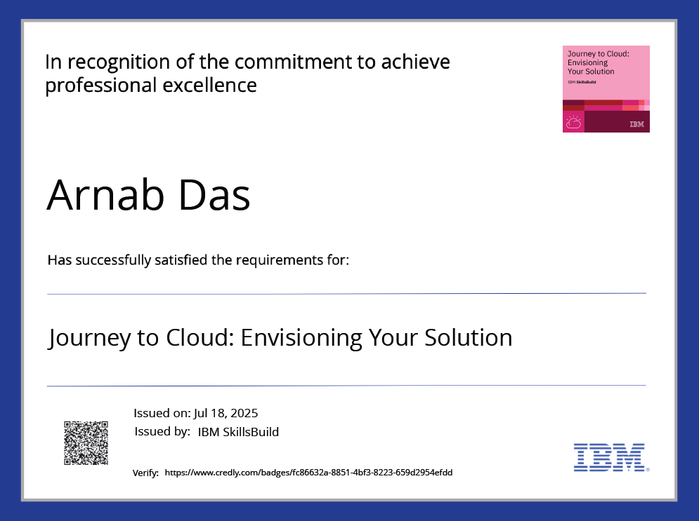
IBM Certifications

Slide 13
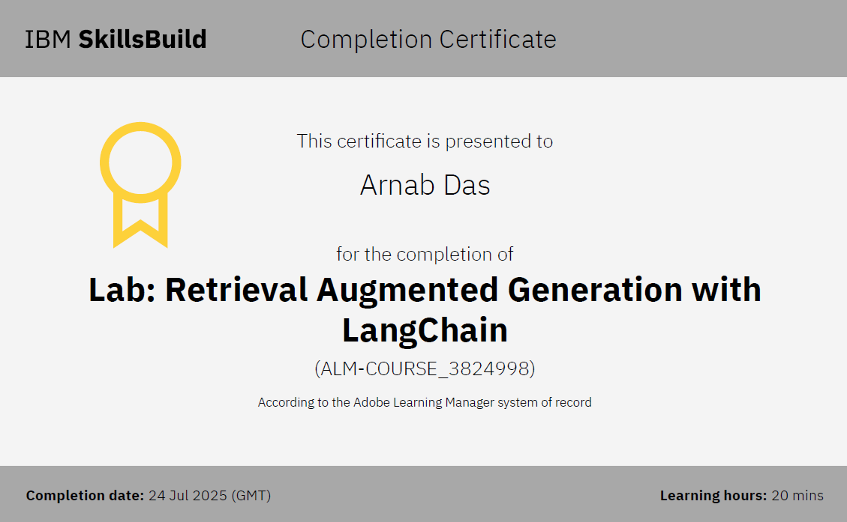
IBM Certifications

Slide 14
THANK YOU

